Slide 1
System modelling

Slide 2
System models
Different models may be produced during the requirements analysis activity
Requirements analysis may involve three structuring activities which result in these different models
  Partitioning – Identifies the structural (part-of) relationships between entities
  Abstraction – Identifies generalities among entities
  Projection – Identifies different ways of looking at a problem

Slide 3
System modelling
System modelling helps the analyst to understand the functionality of the system and models are used to communicate with customers.
Different models present the system from different perspectives
  External perspective showing the system’s context or environment;
  Behavioural perspective showing the behaviour of the system;
  Structural perspective showing the system or data architecture.

Slide 4
Model types
Data processing model showing how the data is processed at different stages.
Composition model showing how entities are composed of other entities.
Architectural model showing principal sub-systems.
Classification model showing how entities have common characteristics are grouped together.
Stimulus/response model showing the system’s reaction to events.

Slide 5
Context models
Context models are used to illustrate the operational context of a system - they show what lies outside the system boundaries.
Social and organisational concerns may affect the decision on where to position system boundaries.
Architectural models show the system and its relationship with other sub systems.

Slide 6
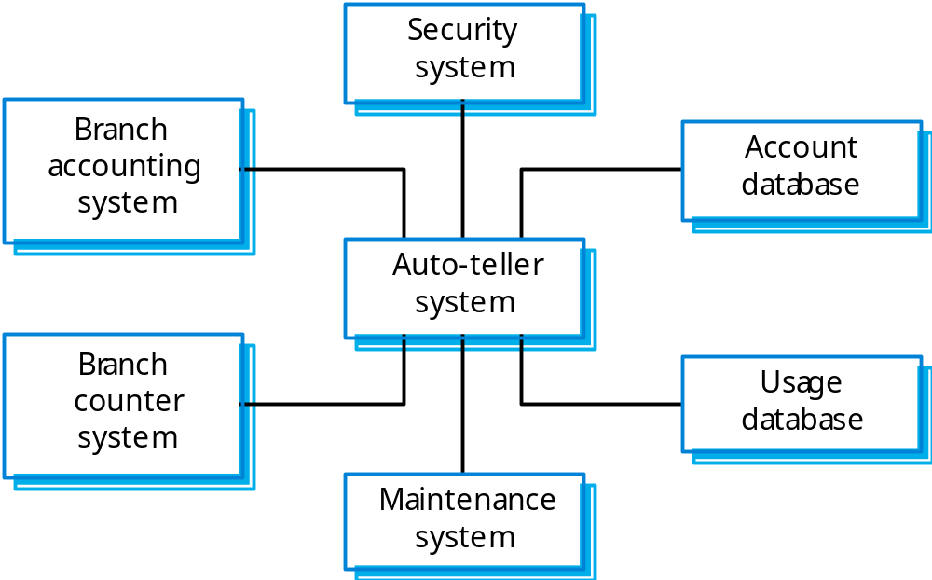
The context of an ATM system

Slide 7
Process models
Process models show the overall process and the processes that are supported by the system.
Data flow models may be used to show the processes and the flow of information from one process to another.

Slide 8
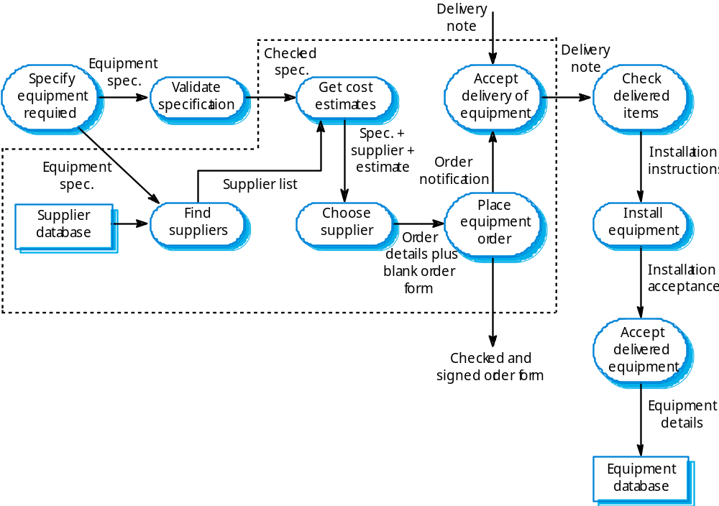
Equipment procurement process

Slide 9
Behavioural models
Behavioural models are used to describe the overall behaviour of a system.
Two types of behavioural model are:
  Data processing models that show how data is processed as it moves through the system;
  State machine models that show the systems response to events.
These models show different perspectives so both of them are required to describe the system’s behaviour.

Slide 10
Data-processing models
Data flow diagrams (DFDs) may be used to model the system’s data processing.
It shows the processing steps as data flows through a system.
DFDs are an intrinsic part of many analysis methods.
Simple and intuitive notation that customers can understand.
Show end-to-end processing of data.

Slide 11
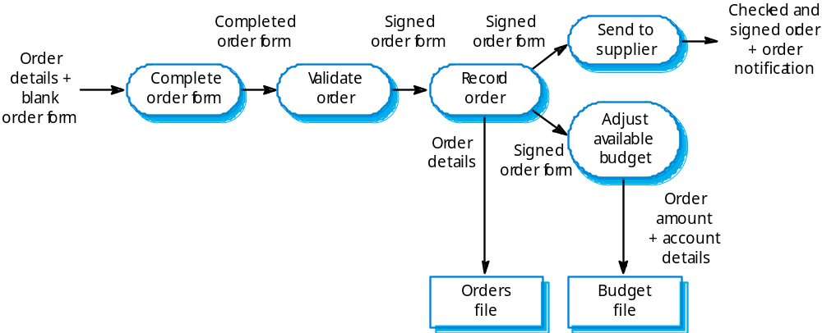
Order processing DFD

Slide 12
Data flow diagrams
DFDs model the system from a functional perspective.
Tracking and documenting how the data associated with a process is helpful to develop an overall understanding of the system.
Data flow diagrams may also be used in showing the data exchange between a system and other systems in its environment.

Slide 13
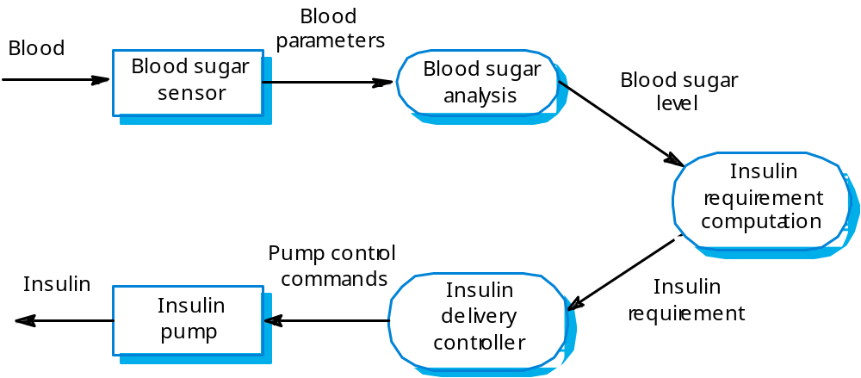
Insulin pump DFD

Slide 14
State machine models
This will generate the model of the behaviour of the system in response to external and internal events.
They show the system’s responses or stimuli, so are often used for modelling real-time systems.
State machine models show system states as nodes and events as arcs between these nodes. When an event occurs, the system moves from one state to another.
Statecharts are an integral part of the UML and are used to represent state machine models.

Slide 15
Statecharts
Allow the decomposition of a model into sub-models (see following slide).
A brief description of the actions is included following the ‘do’ in each state.
Can be complemented by tables describing the states and the stimuli.

Slide 16
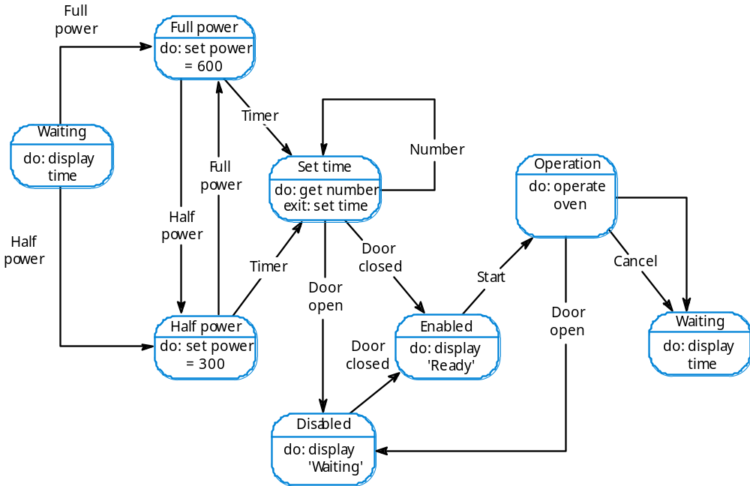
Microwave oven model

Slide 17
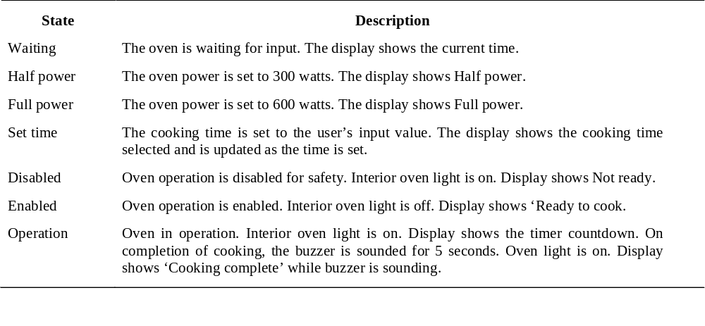
Microwave oven state description

Slide 18
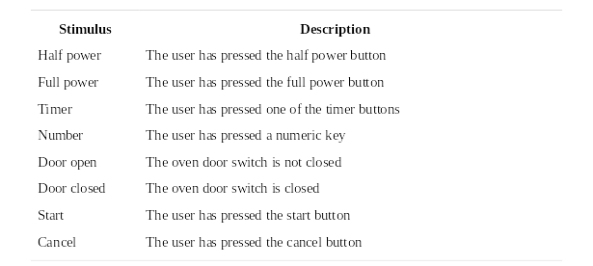
Microwave oven stimuli

Slide 19
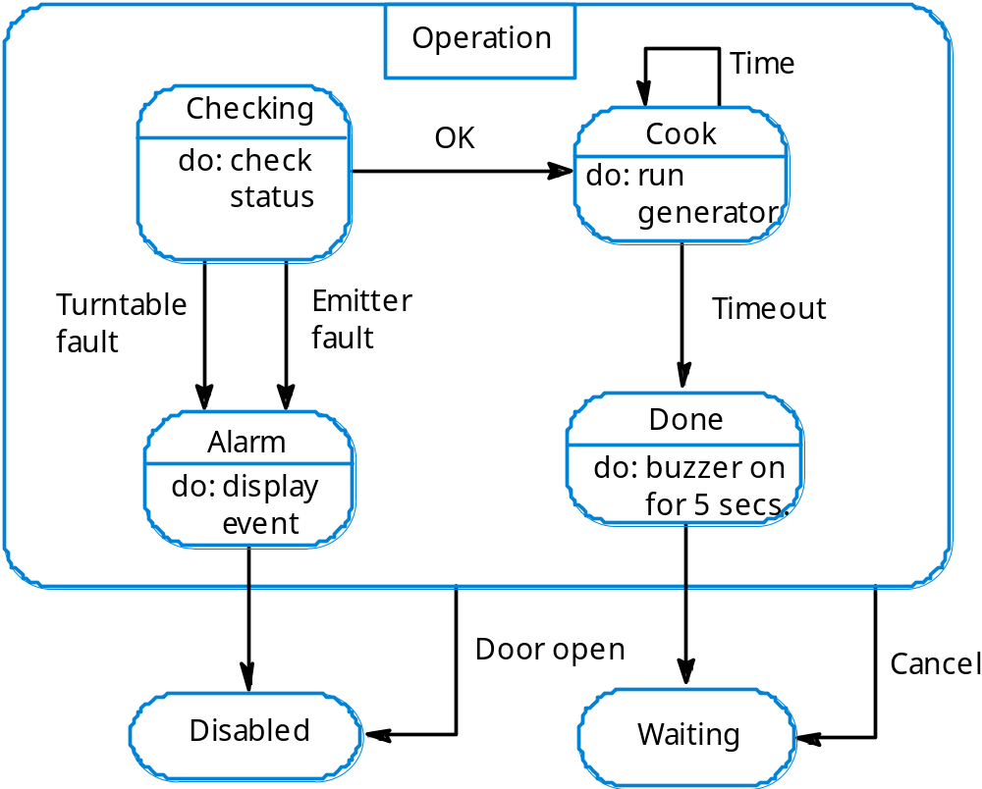
Microwave oven operation

Slide 20
Semantic data models
Used to describe the logical structure of data processed by the system.
An entity-relation-attribute model sets out the entities in the system, the relationships between these entities and the entity attributes
Widely used in database design. Can readily be implemented using relational databases.
No specific notation provided in the UML but objects and associations can be used.

Slide 21
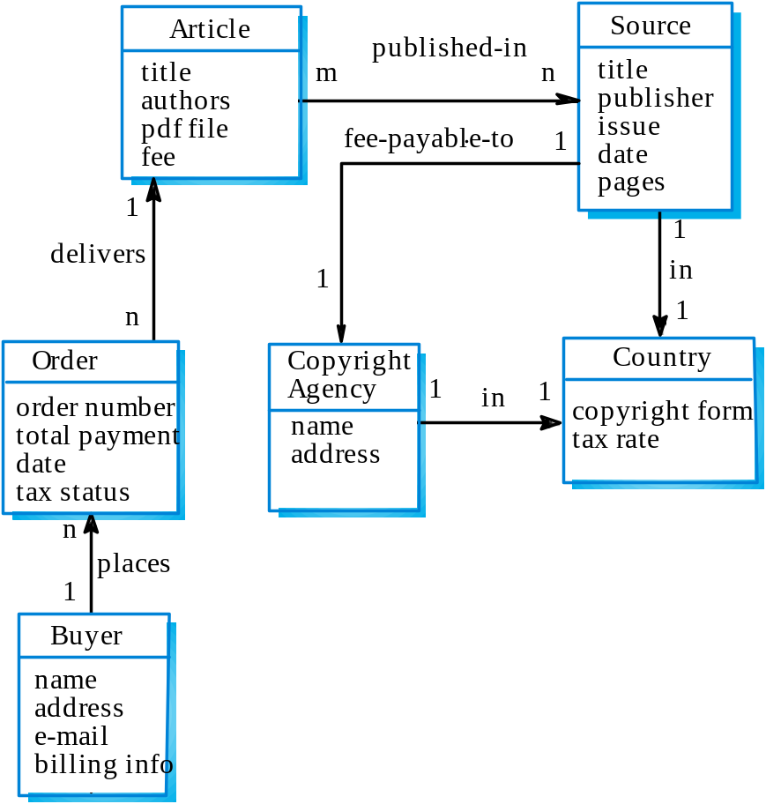
Library semantic model

Slide 22
Data dictionaries
Data dictionaries are the lists of all of the names used in the system models. Descriptions of the entities, relationships and attributes are also included.
Advantages
  Support name management and avoid duplication;
  Store of organisational knowledge linking analysis, design and implementation;
Many CASE workbenches support data dictionaries.

Slide 23
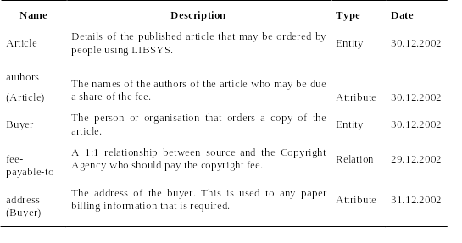
Data dictionary entries

